Slide 1
Evaluating sources
RA Library
2020
^{Towards amore resilient nation}

Slide 2
Evaluating Resources
Evaluating sources is:
Useful thinking skill academically and for everyday life.
How do we evaluate sources?
By evaluating and identifying the source:
Author
Audience
Review process
Currency
Perspective

Slide 3
Evaluating Resources
Author?
Who created the source?
Is he/she credible?
Is there a list of references?
Number of citations? (for scholarly sources).
Audience?
Who is the author speaking to? General public, experts, special interest group

Slide 4
Evaluating Resources
Review process
Has the source been peer reviewed? credibility
Currency
How recent is the source?
Sometimes older is better
Perspective
What is the purpose of the source?
Education, factual, influence, selling something…etc.

Slide 5
Evaluating Websites
Evaluating Websites
Anyone can add information on the internet.
Anyone can create a website.
Anyone can publish an article or a book.
BUT
Is that person an expert in the topic?
Is the information up to date?
Is the information accurate?
Is the information bias?
Is it commercial?

Slide 6
Evaluating Websites
The 5 Ws
Who
Who wrote the pages
Is that person an expert
Can you find any information about the author
Is there a way to contact the author
What?
What is the purpose of the site
Are there a lot of adds
Does the site reflect bias opinions
Is it easy to use
Is it clear and well designed
Is the information accurate

Slide 7
Evaluating Websites
The 5 Ws
When?
When was it created
Is it updated regularly
The links provided works or not
Where?
Where does the information come from
Are there any references
What is the domain of the site: ORG, NET, COM, GOV, EDU
Does the URL include the name of the organization, institution, a person name
Why?
Why is the information useful
Why should I use information from that site
Why is it better than another source

Slide 8
The C.R.A.P. Method
Currency
When was it written
How recent
Reliability
What kind of information included
Based on your need, is it accurate
Any references available
If there are links, do they work
Authority
Who is the author
Is contact information available
Who is the publisher
Are there any adds on the web site
Purpose
Is the information fact or opinion based
Do you feel that it’s bias
Who is the intended audience

Slide 9
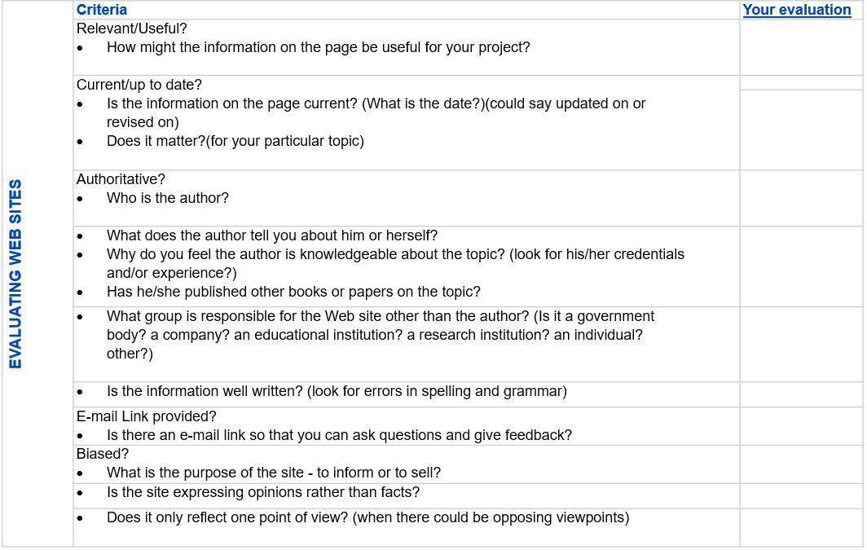
Evaluating Websites

Slide 10
Thank you
Towards a more resilient nation

